Slide 1
EmpowHer
EmpowHER: Empowering Girls for Corporate Excellence Technical Curriculum Python

Slide 2
Agenda
What is python
Interpreter vs Compilers
The Wizardry of Python
Pandas
Case Study
Beyond the Horizon with Python

Slide 3
What is Python

Slide 4
Python: Code Unleashed
High-Level Programming Language: Python is an interpreted, high-level, general-purpose programming language.
Easy Syntax: Known for its easy-to-understand syntax, making it a great language for beginners.
Versatile: Used in various domains like web development, data analysis, AI, and machine learning.
Libraries and Frameworks: Rich set of libraries (NumPy, Pandas) and frameworks (Django, Flask) for various tasks.
Cross-Platform: Python is portable and can run on various software and hardware platforms.
Community Support: Large global community providing extensive support and resources.

Slide 5
Interpreter vs Compilers

Slide 6
What is an interpreter
Interpreters: Execute instructions directly in programming language.
Interpreters are slower (line by line), compilers are faster (entire program).
Debugging is easier in interpreters (stops at error), harder in compilers (scans whole program)
Ideal for scripting languages and frequent changes (e.g., Python, JavaScript)

Slide 7
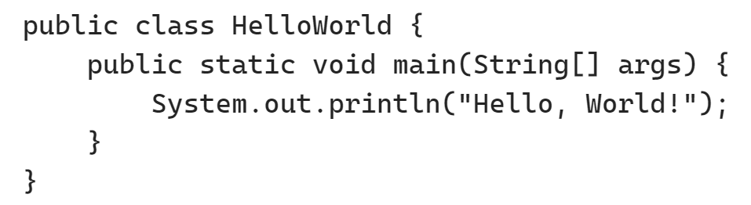
Hello World
print(“Hello, World!)
Java
Python

Slide 8
The Wizardry of Python

Slide 9
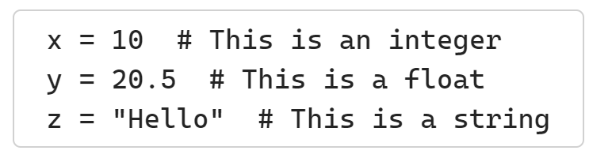
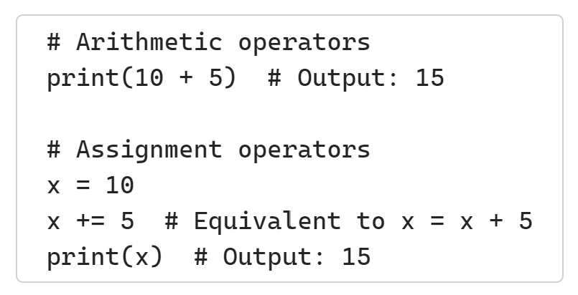
Basic Syntax
Python uses indentation to define blocks of code.
Comments in Python start with the hash character (#).
Python has several data types, including integers, floats, strings, and booleans.
Python has a variety of operators, such as arithmetic operators (+, -, *, /, %) and assignment operators (=, +=, -=).

Slide 10
Data types
Numeric Types:
int: Integer, a whole number positive or negative. For example, 5, 0, -10.
float: Floating point number, a number that contains a decimal. For example, 5.0, 1.6, -9.2.
Sequence Types:
str: String, a sequence of Unicode characters. For example, "hello", "Python".
list: List, an ordered and mutable collection of items. For example, [1, 2, 3], ["apple", "banana", "cherry"].
tuple: Tuple, an ordered and immutable collection of items. For example, (1, 2, 3), ("apple", "banana", "cherry").
Mapping Type:
dict: Dictionary, an unordered collection of key-value pairs. For example, {"name": "John", "age": 30}.
Set Types:
set: Set, an unordered collection of unique items. For example, {1, 2, 3}, {"apple", "banana", "cherry"}
Boolean Type:
bool: Boolean, a type with two values: True and False.

Slide 11
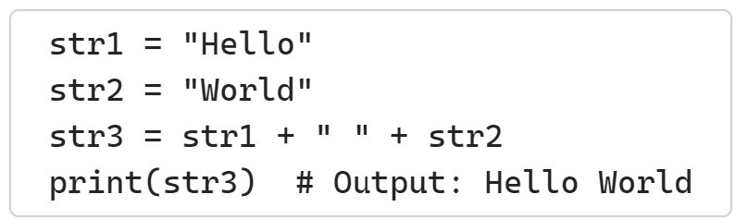
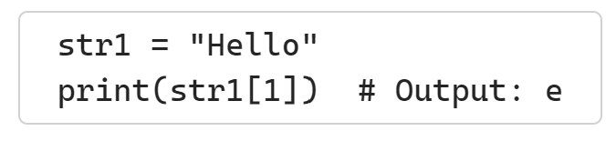
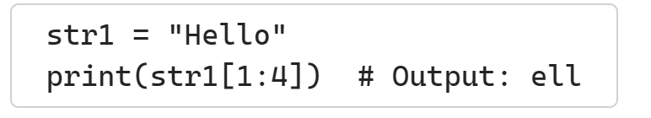
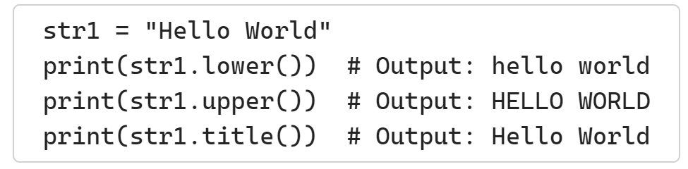
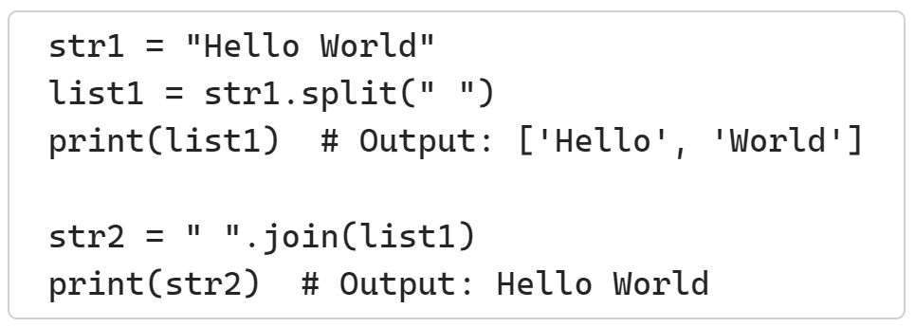
String Manipulation
Concatenation: You can combine strings using the + operator.
Indexing: You can access individual characters in a string using their indices.
Slicing: You can get a substring from a string using slicing.
Case Conversion: The lower(), upper(), and title() methods convert a string to lowercase, uppercase, and title case respectively.
Split and Join: The split() method divides a string into a list where each word is an item. The join() method combines a list of strings into a single string

Slide 12
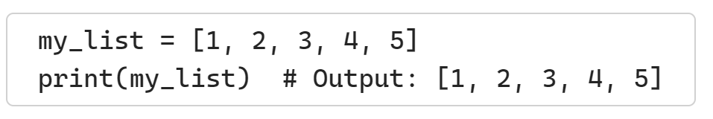
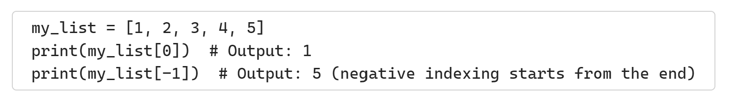
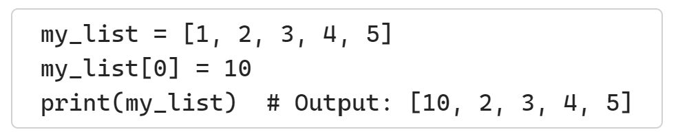
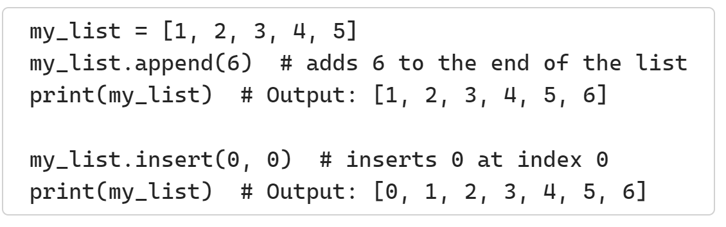
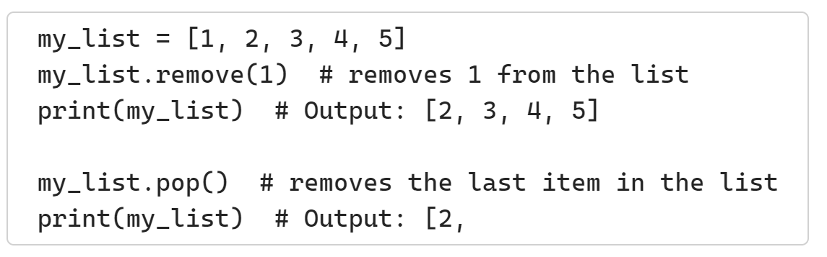
List Operations
Creating a List: A list is created by placing elements in square brackets [], separated by commas.
Accessing Elements: You can access an element in a list by its index. Python lists are zero-indexed.
Modifying a List: Lists are mutable, meaning you can change their content.
Adding Elements: You can add elements to a list with the append() method or insert() method.
Removing Elements: You can remove elements from a list with the remove() method or pop() method.

Slide 13

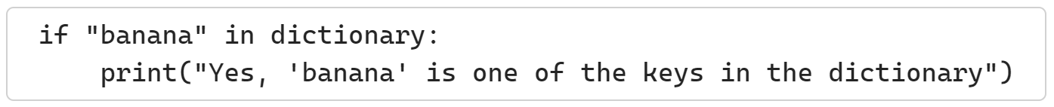
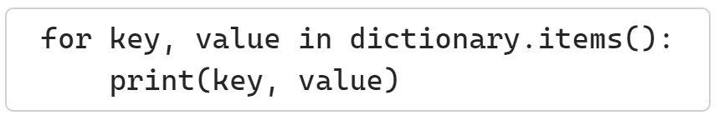
Dictionary Operations
Creating a dictionary: This dictionary contains keys ("apple", "banana", "cherry") and values (1, 2, 3).
Accessing elements: This gives you the value for the key "apple".
Modifying elements: This changes the value for the key "apple" to 10.
Adding elements: This adds a new key-value pair "date": 4 to the dictionary.
Checking if a key exists: This checks if "banana" is a key in the dictionary.
Iterating through a dictionary: This prints all key-value pairs in the dictionary.

Slide 14
Introduction to Pandas’ DataFrame
A Library that is Used for Data Manipulation and Analysis Tool
Using Powerful Data Structures

Slide 15
Pandas First Steps: install and import
Open command prompt and install it using the following commands:
To import pandas we usually import it with a shorter name since it's used so much:
$ pip install pandas
import pandas as pd

Slide 16
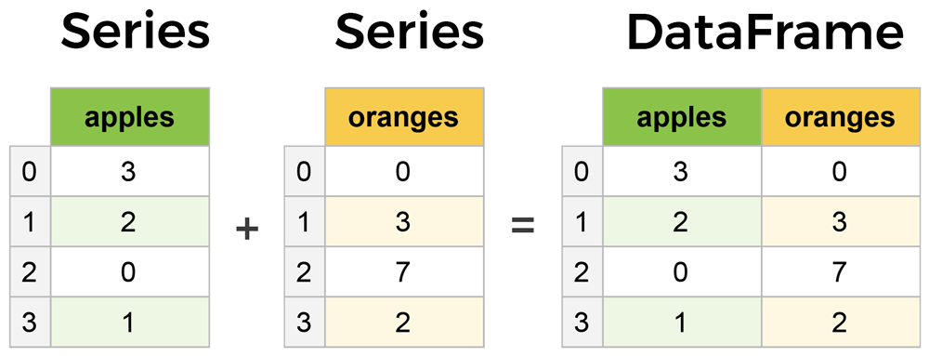
Core components of pandas: Series & DataFrames
The primary two components of pandas are the Series and DataFrame.
Series is essentially a column, and
DataFrame is a multi-dimensional table made up of a collection of Series.
DataFrames and Series are quite similar in that many operations that you can do with one you can do with the other, such as filling in null values and calculating the mean.
A Data frame is a two-dimensional data structure, i.e., data is aligned in a tabular fashion in rows and columns.
columns
Features of DataFrame
Potentially columns are of different types
Size – Mutable
Labeled axes (rows and columns)
Can Perform Arithmetic operations on rows and columns
rows

Slide 17
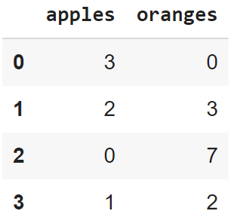
Creating a DataFrame from scratch
There are many ways to create a DataFrame from scratch, but a great option is to just use a simple dict. But first you must import pandas.
Let's say we have a fruit stand that sells apples and oranges. We want to have a column for each fruit and a row for each customer purchase. To organize this as a dictionary for pandas we could do something like:
And then pass it to the pandas DataFrame constructor:
import pandas as pd
data = { 'apples':[3, 2, 0, 1] , 'oranges':[0, 3, 7, 2] }
df = pd.DataFrame(data)

Slide 18
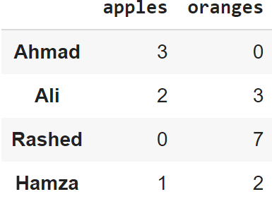
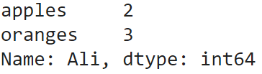
How did that work?
Each (key, value) item in data corresponds to a column in the resulting DataFrame.
The Index of this DataFrame was given to us on creation as the numbers 0-3, but we could also create our own when we initialize the DataFrame.
E.g. if you want to have customer names as the index:
df = pd.DataFrame(data, index=['Ahmad', 'Ali', 'Rashed', 'Hamza'])
So now we could locate a customer's order by using their names:
df.loc['Ali']

Slide 19
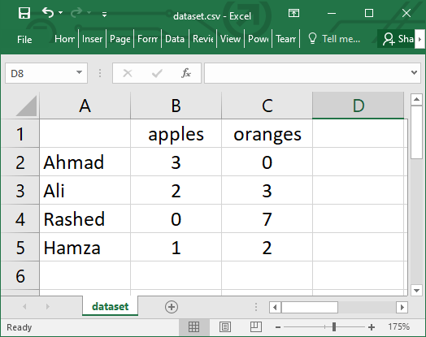
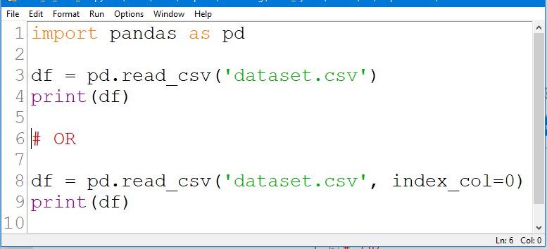
Reading data from a CSV file

Slide 20
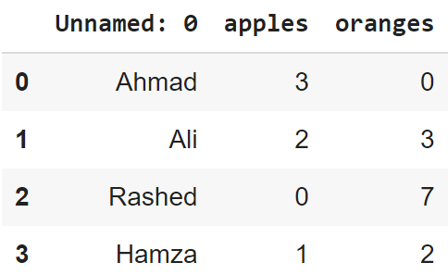
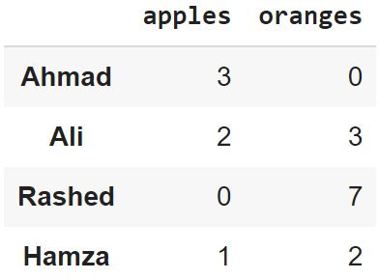
Reading data from CSVs
With CSV files, all you need is a single line to load in the data:
df = pd.read_csv('dataset.csv')
CSVs don't have indexes like our DataFrames, so all we need to do is just designate the index_col when reading:
df = pd.read_csv('dataset.csv', index_col=0)
Note: here we're setting the index to be column zero.

Slide 21
Converting back to a CSV or JSON
So after extensive work on cleaning your data, you’re now ready to save it as a file of your choice. Similar to the ways we read in data, pandas provides intuitive commands to save it:
When we save JSON and CSV files, all we have to input into those functions is our desired filename with the appropriate file extension.
df.to_csv('new_dataset.csv')
df.to_json('new_dataset.json')
df.to_sql('new_dataset', con)

Slide 22
Most important DataFrame operations
DataFrames possess hundreds of methods and other operations that are crucial to any analysis.
As a beginner, you should know the operations that:
that perform simple transformations of your data and those
that provide fundamental statistical analysis on your data.

Slide 23
Loading dataset
For our demo we will take a demo data set (download link)
Extract and copy the movies.csv and ratings.csv file into your working directory
We're loading this dataset from a CSV and designating the movie titles to be our index.
movies_df = pd.read_csv("movies.csv", index_col="title")

Slide 24
Viewing your data
The first thing to do when opening a new dataset is print out a few rows to keep as a visual reference. We accomplish this with .head():
.head() outputs the first five rows of your DataFrame by default, but we could also pass a number as well: movies_df.head(10) would output the top ten rows, for example.
To see the last five rows use .tail() that also accepts a number, and in this case we printing the bottom two rows.:
movies_df.head()
movies_df.tail(2)

Slide 25
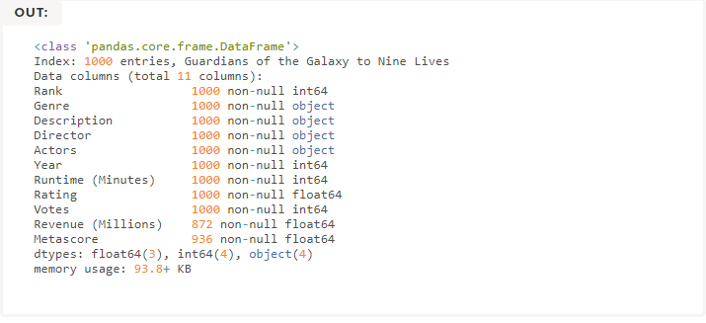

Getting info about your data
.info() should be one of the very first commands you run after loading your data
.info() provides the essential details about your dataset, such as the number of rows and columns, the number of non-null values, what type of data is in each column, and how much memory your DataFrame is using.
movies_df.info()
movies_df.shape

Slide 26


Handling duplicates
This dataset does not have duplicate rows, but it is always important to verify you aren't aggregating duplicate rows.
To demonstrate, let's simply just double up our movies DataFrame by appending it to itself:
Using append() will return a copy without affecting the original DataFrame. We are capturing this copy in temp so we aren't working with the real data.
Notice call .shape quickly proves our DataFrame rows have doubled.
temp_df = movies_df.append(movies_df)
temp_df.shape
Now we can try dropping duplicates:
temp_df = temp_df.drop_duplicates()
temp_df.shape

Slide 27
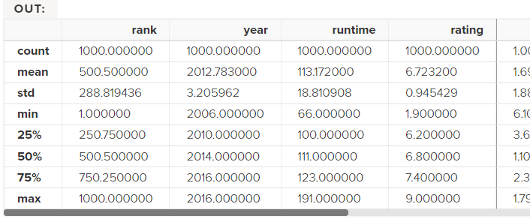
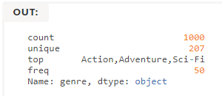
Understanding your data
Using .describe() on an entire DataFrame we can get a summary of the distribution of continuous variables:
.describe() can also be used on a categorical variable to get the count of rows, unique count of categories, top category, and freq of top category:
This tells us that the genre column has 207 unique values, the top value is Action/Adventure/Sci-Fi, which shows up 50 times (freq).
movies_df.describe()
movies_df['genre'].describe()

Slide 28
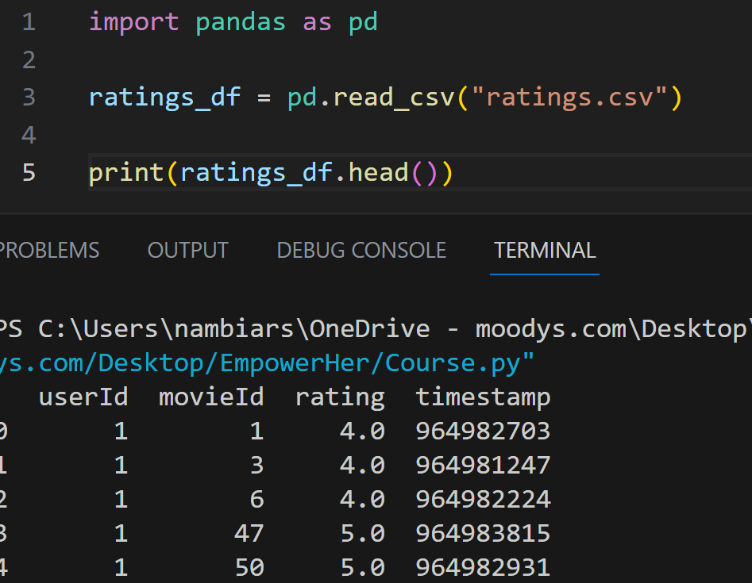
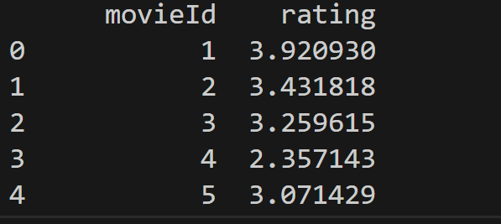
Group Data
Read the ratings.csv file
In the ratings_df we have a column movieId,userId and ratings
Let's group the data by movieId . When we group data, we need to apply aggregate function over other columns
As an exercise let's find the average rating of movies which the users have Collaboratory rated
averageRating_df = ratings_df.groupby('movieId', as_index=False).agg({'rating':'mean'})
Inside the agg function we need to pass a dictionary where the key is the column name and the value is the aggregate function we need to apply over it
As we can see we successfully aggregated and found the average rating for each movie id

Slide 29
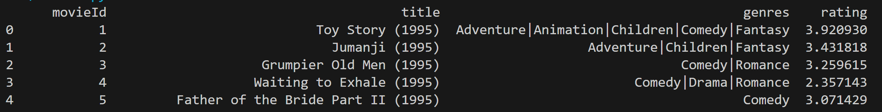
Joining Data
Data will be spread across different systems
Pandas gives you an option to merge different dataframes
Let's merge the movies dataframe and the averageRating dataframes to geta a comprehensive view
master_data = pd.merge(movies_df, averageRating_df,how="left",on="movieId")
Data will be spread across different systems
Pandas gives you an option to merge different dataframes
Let's merge the movies dataframe and the averageRating dataframes to geta a comprehensive view

Slide 30
Filtering Data
Filtering is a useful operation to select specific rows in a DataFrame based on some condition
Let's find the movie with the highest rating
And for the lowest rated movie
value = master_data[ (master_data['rating'] == master_data['rating'].max())]
value = master_data[ (master_data['rating'] == master_data['rating’].min())]

Slide 31
Filtering Data
Let’s filter based on the genre
To find Comedy movies with rating of 5
value = master_data[ (master_data['genres'].str.contains("Comedy") )]
value = master_data[ (master_data['genres'].str.contains("Comedy")) & (master_data['rating']==5)]

Slide 32
Beyond the Horizon with Python
AI & ML: Python's libraries like TensorFlow and PyTorch are revolutionizing AI.
Data Science: Python simplifies data analysis and visualization with Pandas and Matplotlib.
Web Development: Python's Django and Flask frameworks are reshaping web development.
Cybersecurity: Python enhances network security analysis with Scapy and Nmap-python.
FinTech: Python's data handling capabilities are transforming finance with Zipline and Pyfolio.
Prospects: Python's versatility and popularity position it as a key player in future tech.

Slide 33
Appendix
Add Links or permissible Images as needed

